Slide 1

Applied Data Science Capstone Project
Done By:
Amruha Ahmed
GitHub Link:
https://github.com/AmruhaAhmed/IBM-Applied-Data-Science-Capstone-

Slide 2
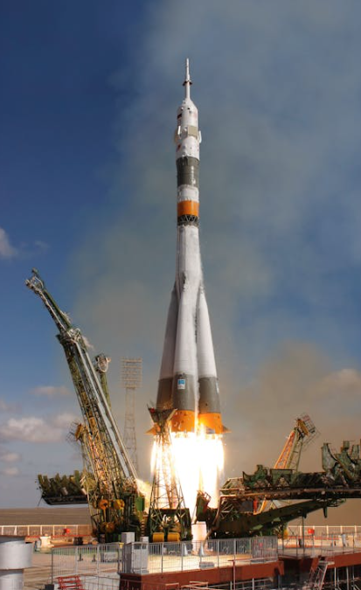
Outline
Executive Summary
Introduction
Methodology
Results
Discussion
Conclusion
https://github.com/AmruhaAhmed/IBM-Applied-Daa-Science-Capstone-

Slide 3
Executive Summary
The following methods were applied to gain a comprehensive picture of the data available:
Data Collection
Data Wrangling
EDA
Interactive Analytical Dashboard
Predictive Analysis
The following points were inferred:
EDA and visualizations using dashboards helped in understanding how each parameter is affected by other and gain valuable insights
Accuracy of predicting whether the first stage of Falcon 9 rocket will land or not is 83.33%
https://github.com/AmruhaAhmed/IBM-Applied-Daa-Science-Capstone-

Slide 4
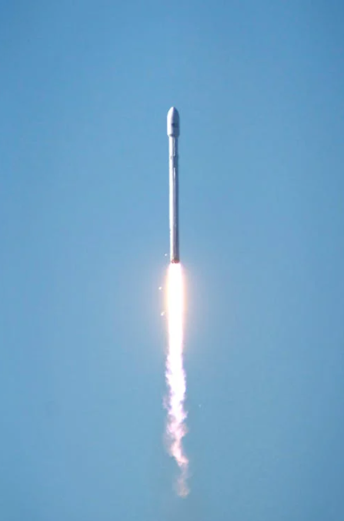
2. Introduction
Space X advertises Falcon 9 rocket launches on its website with a cost of 62 million dollars; other providers cost upward of 165 million dollars each, much of the savings is because Space X can reuse the first stage.
The goal is to
determine the price of each launch for Space Y , that is competing with SpaceX.
Gather information about SpaceX
Creating dashboards for better insights
Whether SpaceX will reuse the first stage of Falcon 9 or not using machine learning
https://github.com/AmruhaAhmed/IBM-Applied-Daa-Science-Capstone-

Slide 5
3. Methodology
Data Collection
Using Web Scraping and API
EDA with SQL , Pandas and Matplotlib
Data Wrangling
Predictive Analysis using Classification
Interactive Visualizations with Folium and Dash
https://github.com/AmruhaAhmed/IBM-Applied-Daa-Science-Capstone-

Slide 6
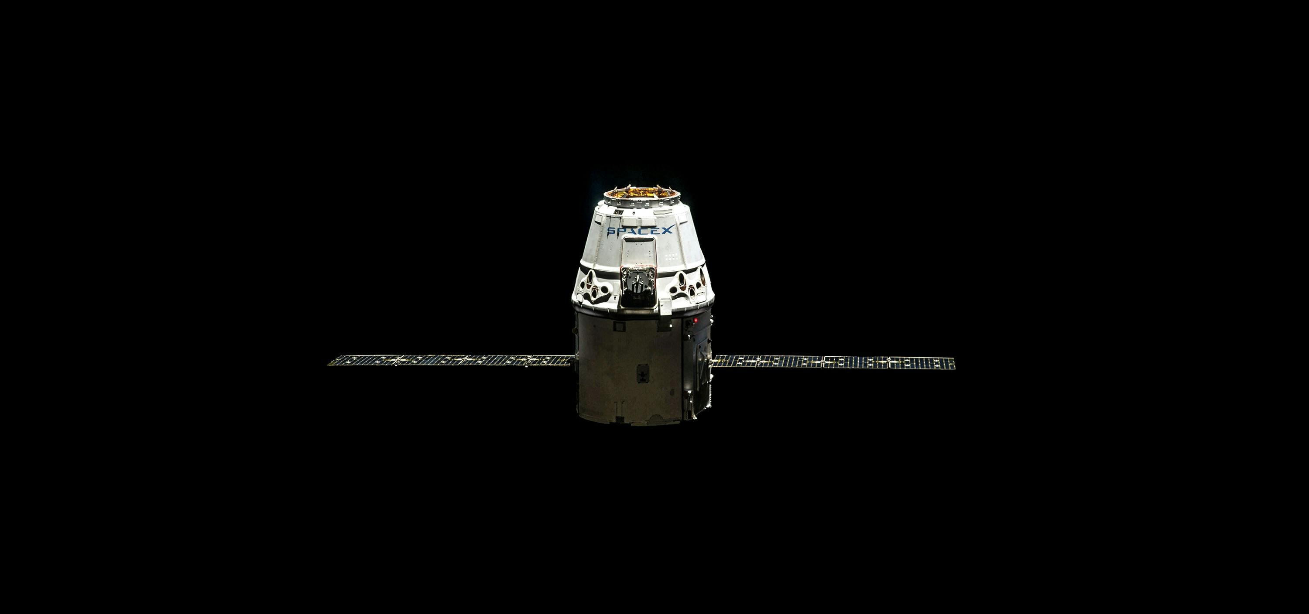
Data Collection
GitHub Link for Data Collection using API:https://github.com/AmruhaAhmed/IBM-Applied-Data-Science-Capstone-/blob/main/data%20collection%20using%20api.ipynb
GitHub Link for Data Collection using Web Scraping: https://github.com/AmruhaAhmed/IBM-Applied-Data-Science-Capstone-/blob/main/data%20collection%20using%20web%20scraping.ipynb

Slide 7
3.1 Data Collection
Data Collection using API
URL is used to target a specific endpoint of the API to get past launch data.
perform a get request using the requests library to obtain the launch data, which we will use to get the data from the API.
Result is views using .json()
To convert JSON into pandas dataframe, json_normalize() is used
Data Collection using Web Scraping
Python BeautifulSoup package is used to web scrape some HTML tables that contain valuable Falcon 9 launch records
Data is parsed from those tables and convert them into a Pandas data frame for further visualization and analysis.
Instances in the data containing Falcon 1 have to be removed
Null values of Payload Mass are filled using the mean of Payload Mass
https://github.com/AmruhaAhmed/IBM-Applied-Daa-Science-Capstone-

Slide 8
Data Wrangling
GitHub Link: https://github.com/AmruhaAhmed/IBM-Applied-Data-Science-Capstone-/blob/main/data%20wrangling.ipynb

Slide 9
3.2 Data Wrangling
Data Wrangling of the dataset involved the following steps
Calculating the number of launches on each site
Calculating the number and instance of each orbit
Calculating the number and ocurrence of mission outcome of the orbits
Create a landing outcome label from Outcome column
Exporting the resultant dataframe into dataset_part_2.csv
https://github.com/AmruhaAhmed/IBM-Applied-Daa-Science-Capstone-

Slide 10
EDA with SQL
GitHub Link: https://github.com/AmruhaAhmed/IBM-Applied-Data-Science-Capstone-/blob/main/eda%20with%20sql.ipynb

Slide 11
3.3.1 EDA with SQL
Exploratory Data Analysis of the dataset using SQL involved the following tasks :
Installing SQL alchemy
Connecting to a database
Displaying the names of the unique launch sites in the space mission
Displaying 5 records where launch sites begin with the string 'CCA'
Displaying the total payload mass carried by boosters launched by NASA (CRS)
Displaying average payload mass carried by booster version F9 v1.1
Listing the date when the first succesful landing outcome in ground pad was acheived.
https://github.com/AmruhaAhmed/IBM-Applied-Daa-Science-Capstone-

Slide 12
3.3.1 EDA with SQL Continued
Listing the names of the boosters which have success in drone ship and have payload mass greater than 4000 but less than 6000
Listing the total number of successful and failure mission outcomes
Listing the names of the booster_versions which have carried the maximum payload mass.
Listing the records which will display the month names, failure landing_outcomes in drone ship ,booster versions, launch_site for the months in year 2015.
Ranking the count of landing outcomes (such as Failure (drone ship) or Success (ground pad)) between the date 2010-06-04 and 2017-03-20, in descending order.

Slide 13
EDA with Pandas and Matplotlib + Feature Engineering
GitHub Link: https://github.com/AmruhaAhmed/IBM-Applied-Data-Science-Capstone-/blob/main/eda%20with%20pandas%20and%20matplotlib.ipynb

Slide 14
3.3.2 EDA with Pandas and Matplotlib
Exploratory Data Analysis of the dataset using Pandas and Matplotlib libraries in Python involved the following tasks :
Visualize the relationship between Flight Number and Launch Site
Visualize the relationship between Payload Mass and Launch Site
Visualize the relationship between success rate of each orbit type
Visualize the relationship between FlightNumber and Orbit type
Visualize the relationship between Payload Mass and Orbit type
Visualize the launch success yearly trend
https://github.com/AmruhaAhmed/IBM-Applied-Daa-Science-Capstone-

Slide 15
3.3.2 Feature Engineering
Feature Enginering of the dataset using Python involved the following tasks :
Create dummy variables to categorical columns of Orbits, Launch Site, Landing Pad, Serial using One Hot Encoding
Cast all numeric columns to `float64`
https://github.com/AmruhaAhmed/IBM-Applied-Daa-Science-Capstone-

Slide 16
Interactive Visualizations with Folium
GitHub Link: https://github.com/AmruhaAhmed/IBM-Applied-Data-Science-Capstone-/blob/main/interactive%20visualizations%20using%20folium.ipynb

Slide 17
3.4.1 Interactive Visualizations with Folium
Interactive Launch Sites Locations Analysis with Folium is done through the following tasks:
create a folium `Map` object,
Create and add `folium.Circle` and `folium.Marker` for each launch site on the site map
Create a new column in `spacex_df` dataframe called `marker_color` to store the marker colors based on the `class` value
Mark the success/failed launches for each site on the map
For each launch result in `spacex_df` data frame, add a `folium.Marker` to `marker_cluster`
Calculate the distances between a launch site to its proximities
https://github.com/AmruhaAhmed/IBM-Applied-Daa-Science-Capstone-

Slide 18
Interactive Dashboard with Dash
GitHub Link: https://github.com/AmruhaAhmed/IBM-Applied-Data-Science-Capstone-/blob/main/interactive%20dashboard%20using%20dash.py

Slide 19
3.4.2 Interactive Dashboard with Dash
The following steps were involved to create an interactive dashboard using Plotly Dash:
Reading the airline data into pandas dataframe
Creating a dash application
Creating an app layout
Adding a dropdown list to enable Launch Site selection
Adding a callback function for `site-dropdown` as input, `success-pie-chart` as output. And a function decorator to specify function input and output
https://github.com/AmruhaAhmed/IBM-Applied-Daa-Science-Capstone-

Slide 20
3.4.2 Interactive Dashboard with Dash Continued
Adding a pie chart to show the total successful launches count for all sites. If a specific launch site was selected, showing the Success vs. Failed counts for the site
Adding a slider to select payload range
Adding a callback function for `site-dropdown` and `payload-slider` as inputs, `success-payload-scatter-chart` as output
Adding a scatter chart to show the correlation between payload and launch success
Running the app
https://github.com/AmruhaAhmed/IBM-Applied-Daa-Science-Capstone-

Slide 21
Predictive Analysis using Classification
GitHub Link: https://github.com/AmruhaAhmed/IBM-Applied-Data-Science-Capstone-/blob/main/predictive%20analysis(classification).ipynb

Slide 22
3.5 Predictive Analysis using Classification
In order to create a machine learning pipeline to predict if the first stage will land, the following steps are used:
Loading the dataframe
Creating a NumPy array from the column Class(target column)
Standardizing the data in independent columns
Using the function train_test_split to split the data X and Y into training and test data and the test size=20 % and training size=80% of the total data
Creating a logistic regression object then create a GridSearchCV object cross validation = 10. Fitting the object to find the best parameters from the dictionary parameters
https://github.com/AmruhaAhmed/IBM-Applied-Daa-Science-Capstone-

Slide 23
3.5 Predictive Analysis using Classification
Creating a support vector machine object then create a GridSearchCV object with cross validation = 10. Fitting the object to find the best parameters from the dictionary parameters.
Creating a decision tree classifier object then create a GridSearchCV object with cross validation = 10. Fitting the object to find the best parameters from the dictionary parameters.
Creating a k nearest neighbors object then create a GridSearchCV object with cv = 10. Fitting the object to find the best parameters from the dictionary parameters.
Making confusion matrix and evaluating the models using accuracy, precision, recall and f1 score
https://github.com/AmruhaAhmed/IBM-Applied-Daa-Science-Capstone-

Slide 24
4. Results
The results are categorized into 5 critical stages
EDA with SQL
EDA with Matplotlib and Pandas
Interactive Visualizations with Folium
Interactive Dashboard using Dash
Predictive Analysis using Classification

Slide 25
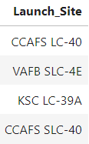
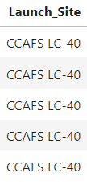
4.1 EDA with SQL
Results of Task 1:Display the names of the unique launch sites in the space mission
Results of Task 2:Display 5 records where launch sites begin with the string 'CCA'
https://github.com/AmruhaAhmed/IBM-Applied-Daa-Science-Capstone-

Slide 26
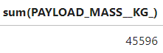
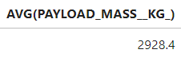
4.1 EDA with SQL
Results of Task 3:Display the total payload mass carried by boosters launched by NASA (CRS)
Results of Task 4:Display average payload mass carried by booster version F9 v1.1
https://github.com/AmruhaAhmed/IBM-Applied-Daa-Science-Capstone-

Slide 27
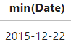
4.1 EDA with SQL
Results of Task 6:List the names of the boosters which have success in drone ship and have payload mass greater than 4000 but less than 6000
Results of Task 5:List the date when the first succesful landing outcome in ground pad was acheived.
https://github.com/AmruhaAhmed/IBM-Applied-Daa-Science-Capstone-

Slide 28
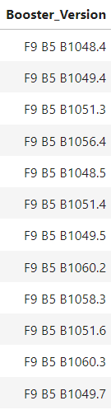
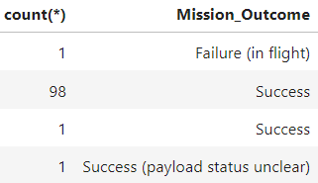
4.1 EDA with SQL
Results of Task 8: List the names of the booster_versions which have carried the maximum payload mass. Use a subquery
Results of Task 7: List the total number of successful and failure mission outcomes
https://github.com/AmruhaAhmed/IBM-Applied-Daa-Science-Capstone-

Slide 29
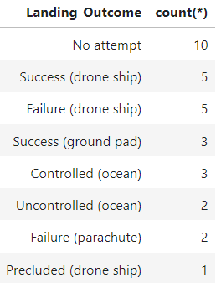
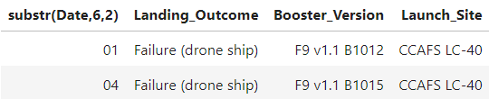
4.1 EDA with SQL
Results of Task 10: Rank the count of landing outcomes (such as Failure (drone ship) or Success (ground pad)) between the date 2010-06-04 and 2017-03-20, in descending order
Results of Task 9: List the records which will display the month names, failure landing_outcomes in drone ship ,booster versions, launch_site for the months in year 2015.
https://github.com/AmruhaAhmed/IBM-Applied-Daa-Science-Capstone-

Slide 30
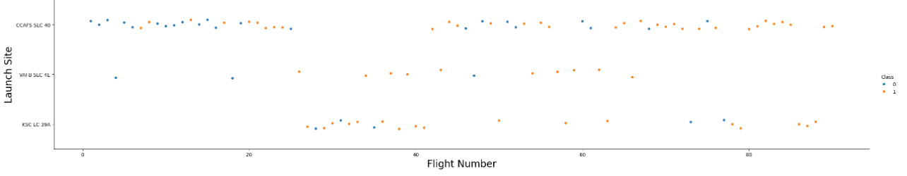
4.2 EDA using Pandas and Matplotlib
Results of Task 1: Visualize the relationship between Flight Number and Launch Site
Insights Gathered : Flight Numbers are higher in CCAFS SLC 40 , with most of them being successful
https://github.com/AmruhaAhmed/IBM-Applied-Daa-Science-Capstone-

Slide 31
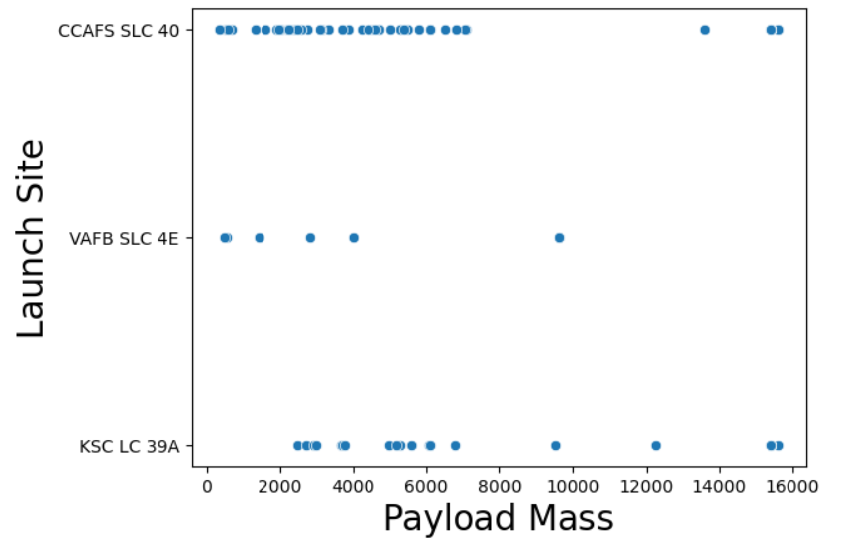
4.2 EDA using Pandas and Matplotlib
Results of Task 2: Visualize the relationship between Payload Mass and Launch Site
Insights Gathered : CCFAS SLC 40 AND KSC LC 39 A have the highest Payload Masses recorded
https://github.com/AmruhaAhmed/IBM-Applied-Daa-Science-Capstone-

Slide 32
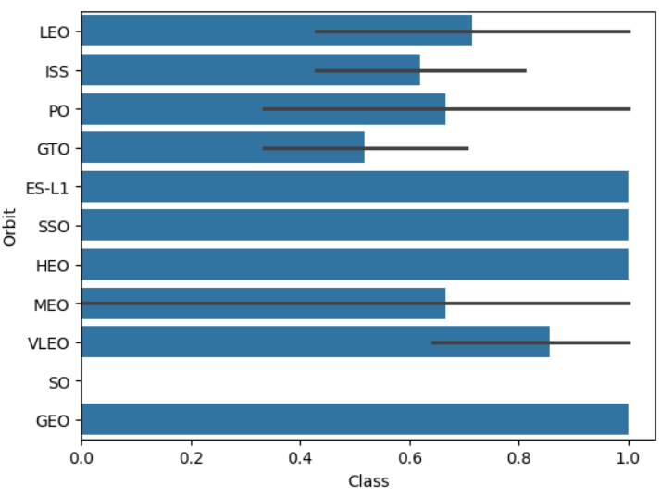
4.2 EDA using Pandas and Matplotlib
Results of Task 3: Visualize the relationship between success rate of each orbit type
Insights Gathered : ES –L1 , SSO,HEO and GEO have the highest success rate whereas SO has the lowest success rate
https://github.com/AmruhaAhmed/IBM-Applied-Daa-Science-Capstone-

Slide 33
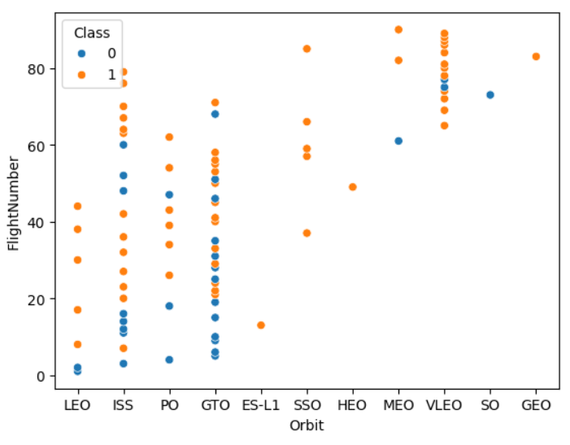
4.2 EDA using Pandas and Matplotlib
Results of Task 4 : Visualize the relationship between FlightNumber and Orbit type
Insights Gathered : In LEO orbit, higher number of flights has higher success rate. IN SSO, each flight has high success rate but there is no clear pattern fr the rest of the orbits
https://github.com/AmruhaAhmed/IBM-Applied-Daa-Science-Capstone-

Slide 34
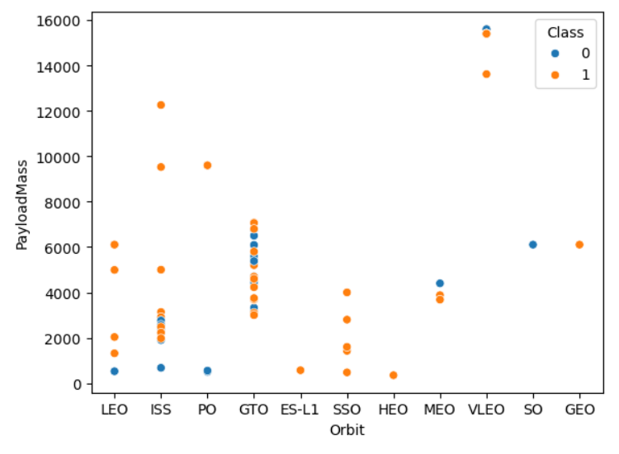
4.2 EDA using Pandas and Matplotlib
Results of Task 5: Visualize the relationship between Payload Mass and Orbit type
Insights Gathered : for orbit types LEO, SSO, higher payload mass guarentees success rate
https://github.com/AmruhaAhmed/IBM-Applied-Daa-Science-Capstone-

Slide 35
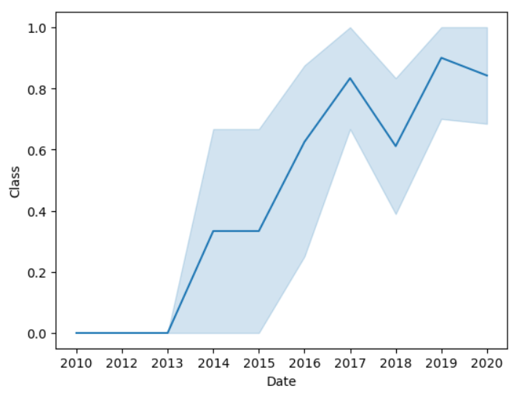
4.2 EDA using Pandas and Matplotlib
Results of Task 6: Visualize the launch success yearly trend
Insights Gathered : there is a steady increase in success rate form 2010 to 2020 , with a slight dip in 2018
https://github.com/AmruhaAhmed/IBM-Applied-Daa-Science-Capstone-

Slide 36
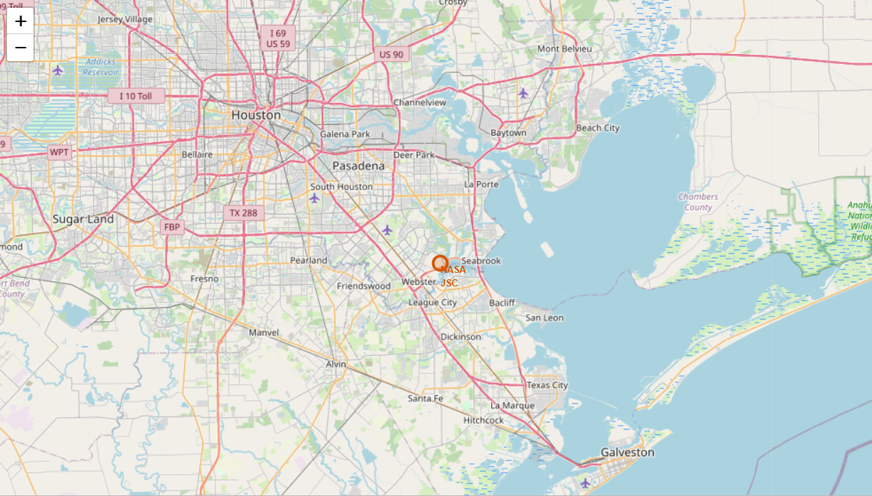
4.3 Interactive Visualizations with Folium
folium Map object, with an initial center location to be NASA Johnson Space Center at Houston, Texas.
https://github.com/AmruhaAhmed/IBM-Applied-Daa-Science-Capstone-

Slide 37
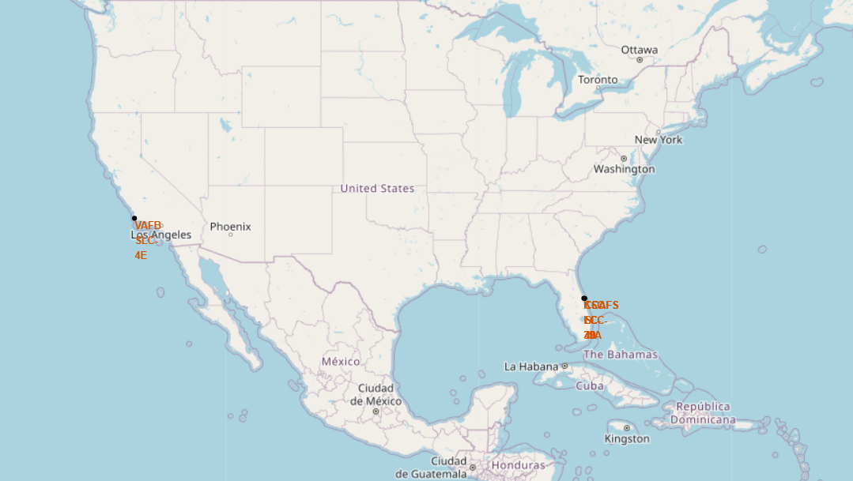
4.3 Interactive Visualizations with Folium
Marking Launch Sites on the Map
https://github.com/AmruhaAhmed/IBM-Applied-Daa-Science-Capstone-

Slide 38
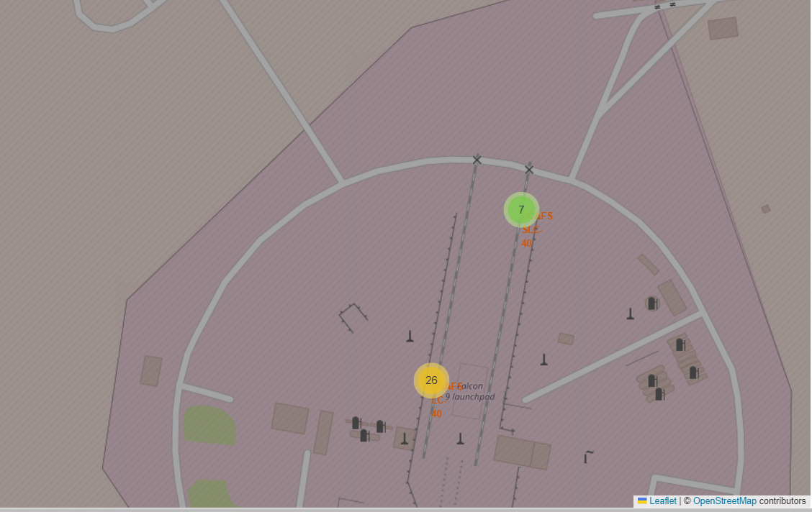
4.3 Interactive Visualizations with Folium
Creating markers for all launch records
https://github.com/AmruhaAhmed/IBM-Applied-Daa-Science-Capstone-

Slide 39
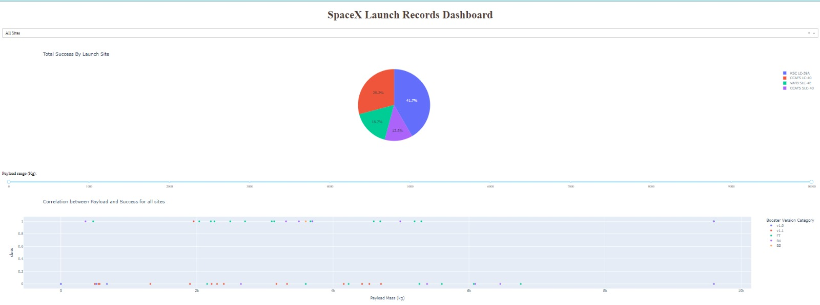
4.4 Interactive Dashboard using Dash
View of the entire dashboard with dropdown and slider
https://github.com/AmruhaAhmed/IBM-Applied-Daa-Science-Capstone-

Slide 40
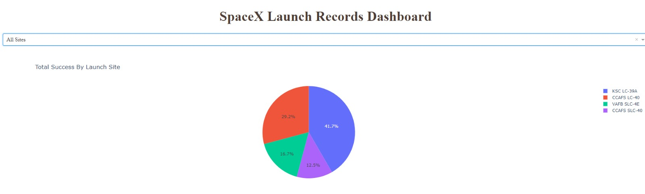
4.4 Interactive Dashboard using Dash
KSC LC 39 A has the highest total success by launch site
CCAFS SLC 40 has the least success by launch site
https://github.com/AmruhaAhmed/IBM-Applied-Daa-Science-Capstone-

Slide 41
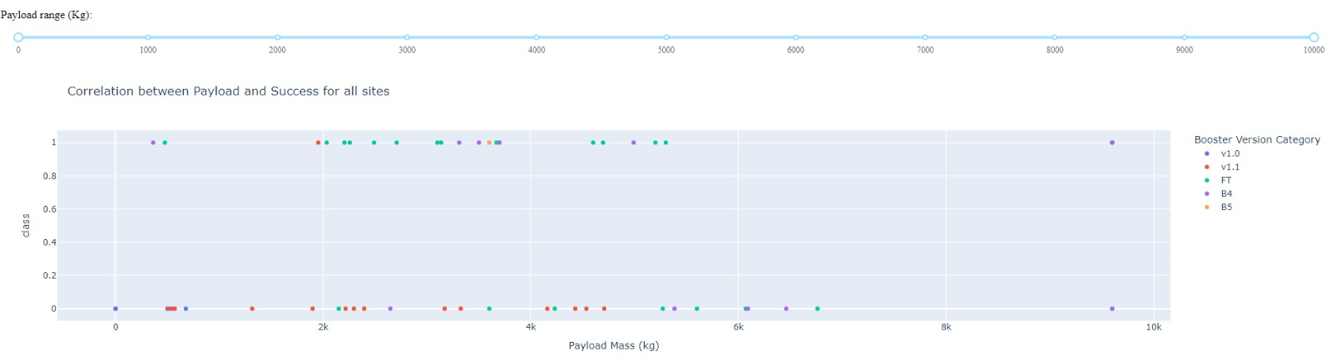
4.4 Interactive Dashboard using Dash
Graph for Correlation between Payload and Success for all sites
Made interactive using the filters of payload range and Launch sites drop down
2k to 6k payload range has the highest amount of success rate
FT Booster Version has the highest amount of success rate
https://github.com/AmruhaAhmed/IBM-Applied-Daa-Science-Capstone-

Slide 42
4.5 Predictive Analysis using Classification
Model | Best Parameters Chosen
Logistic Regression | 'C'= 0.01, 'penalty'='l2', 'solver'= 'lbfgs'
Support Vector Machine | 'C'= 1.0, 'gamma'= 0.03162277660168379, 'kernel'= 'sigmoid'
Decision Tree | 'criterion'='gini', 'max_depth'= 2, 'max_features'= 'sqrt', 'min_samples_leaf'= 1, 'min_samples_split'= 5, 'splitter'= 'random'
K Nearest Neighbors | 'algorithm'= 'auto', 'n_neighbors'= 10, 'p'= 1
https://github.com/AmruhaAhmed/IBM-Applied-Daa-Science-Capstone-

Slide 43
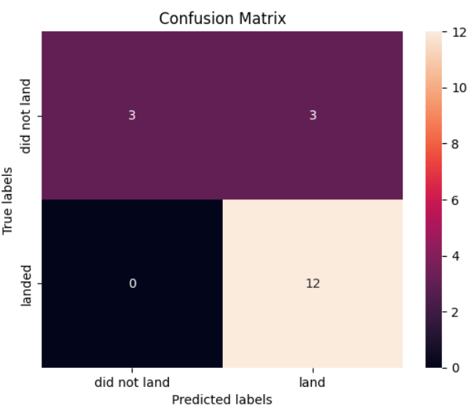
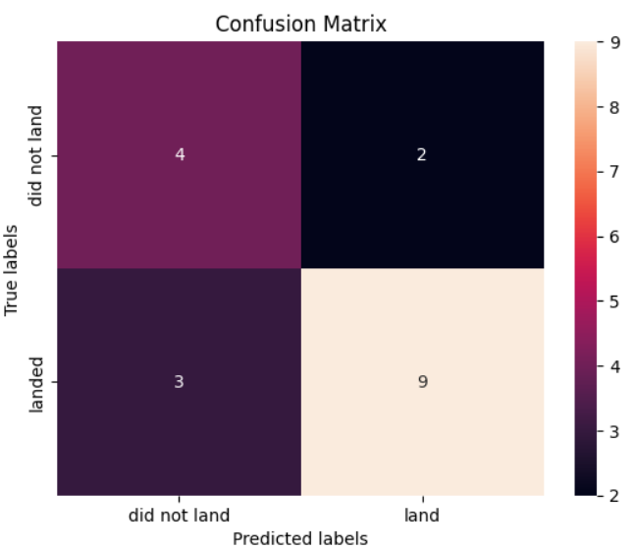
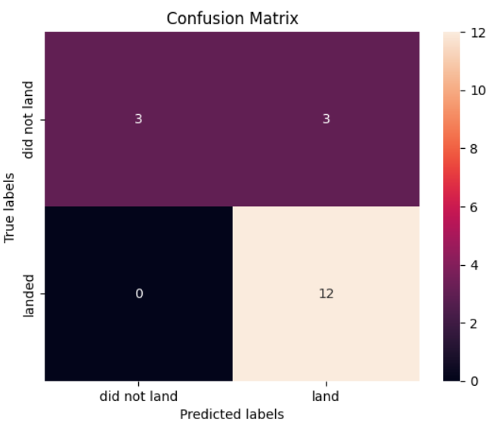
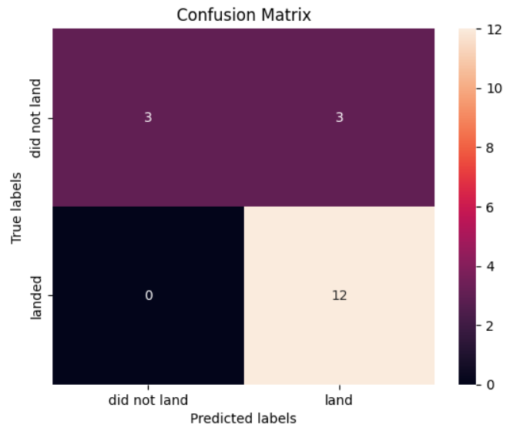
4.5 Predictive Analysis using Classification
Confusion Matrix for Logistic Regression
Confusion Matrix for Decision Tree
Confusion Matrix for Support Vector Machine
Confusion Matrix for K Nearest Neighbors
https://github.com/AmruhaAhmed/IBM-Applied-Daa-Science-Capstone-

Slide 44
4.5 Predictive Analysis using Classification
Model | accuracy | precision | recall | F1 score
Logistic Regression | 0.8333333333333 | 0.8 | 1 | 0.88888888
Support Vector Machine | 0.83333333333333 | 0.8 | 1 | 0.88888888
Decision Tree | 0.72222222222222 | 0.81818 | 0.75 | 0.7826086
K Nearest Neighbors | 0.833333333333 | 0.8 | 1 | 0.88888888
https://github.com/AmruhaAhmed/IBM-Applied-Daa-Science-Capstone-

Slide 45
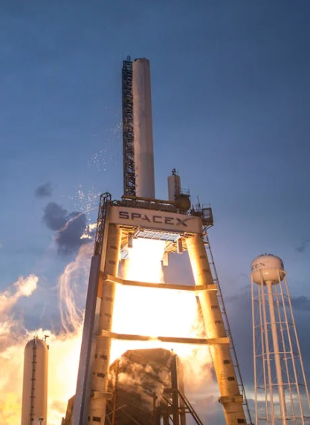
5. Conclusion
KNN, SVM and Logistic Regression are the best performing models
Flight Numbers are higher in CCAFS SLC 40 , with most of them being successful
CCFAS SLC 40 AND KSC LC 39 A have the highest Payload Masses recorded
KSC LC 39 A has the highest total success by launch site
CCAFS SLC 40 has the least success by launch site
2k to 6k payload range has the highest amount of success rate
FT Booster Version has the highest amount of success rate
https://github.com/AmruhaAhmed/IBM-Applied-Daa-Science-Capstone-

Slide 46
Thank You
https://github.com/AmruhaAhmed/IBM-Applied-Daa-Science-Capstone-

